Slide 1
Make gimbal sulution
uit-2015

Slide 2
Version History
Version | Contents | Arthour | Date | Note
1.0 | Create Documet. Designed soulution | TaiVH | 26/06/2015
2.0 | Edit document | TaiVH | 12/07/2015

Slide 3
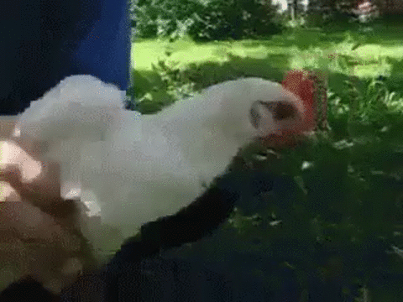
Goal
This is a camera
... and we make this structure (read area)

Slide 4
Solution
Design solution.
Chosing microcontroller and IMU.
Coding solution.

Slide 5
Design sulution list
Using pico servo with micro camera.
Using pico servo only.
Using standard servo.
Reuse DVD brushless motor.
By new brushless motor.
Proversion, by new a gimbal and then coding only
Final Sulution

Slide 6
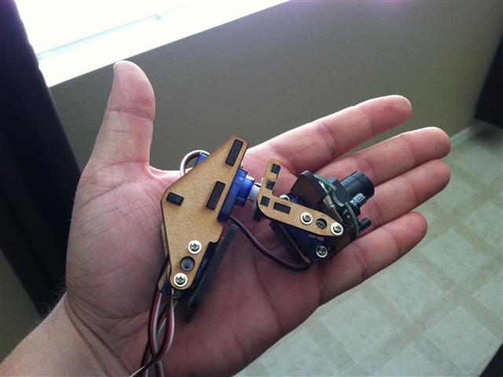
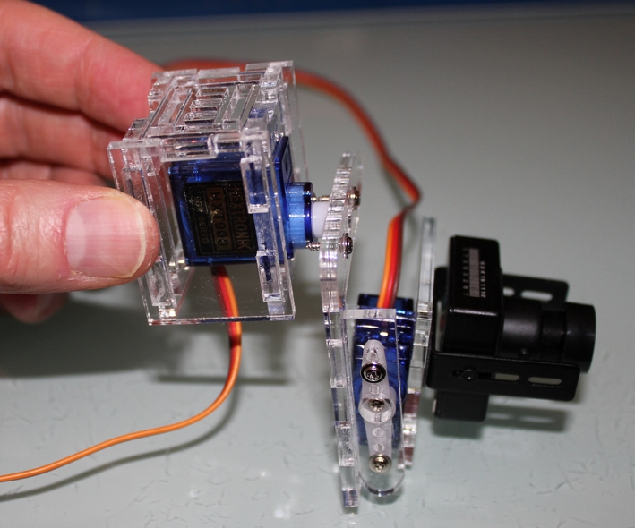
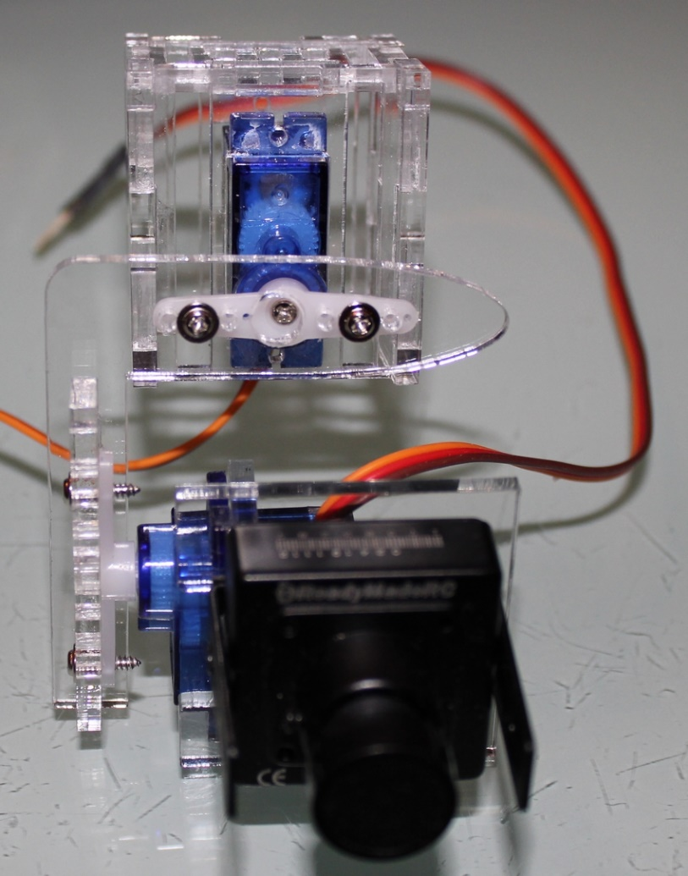
1. Using pico servo with micro camera. 1

Slide 7
1. Using pico servo with micro camera. 2
Advance
Very easy to make.
Very cheap:
3 micro servo price aboult 150k
Coding for only IMU and PID. Don’t have construction for rc servo
Disadvance
Small, pico camera isn’t suitable for HD videos.

Slide 8
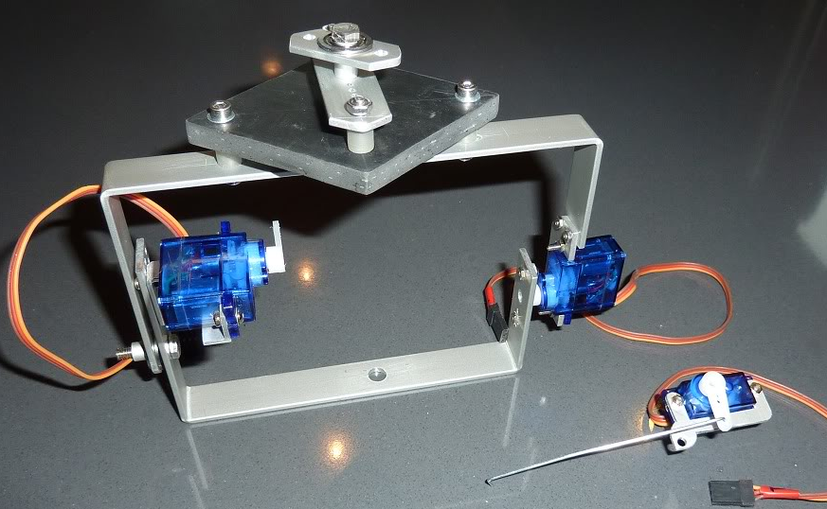
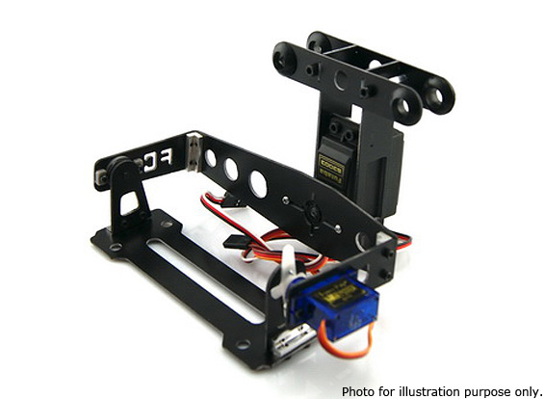
2. Using pico servo only
Easy to make and coding.
Camera can bigger than above situation but we don’t know pico servo have enough strength to carry the camera.
It look simple ☹.

Slide 9
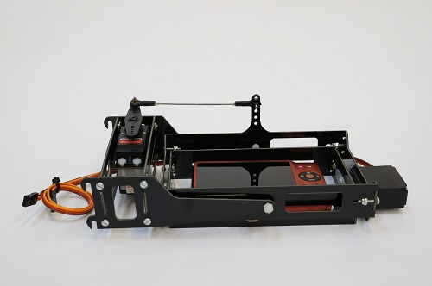
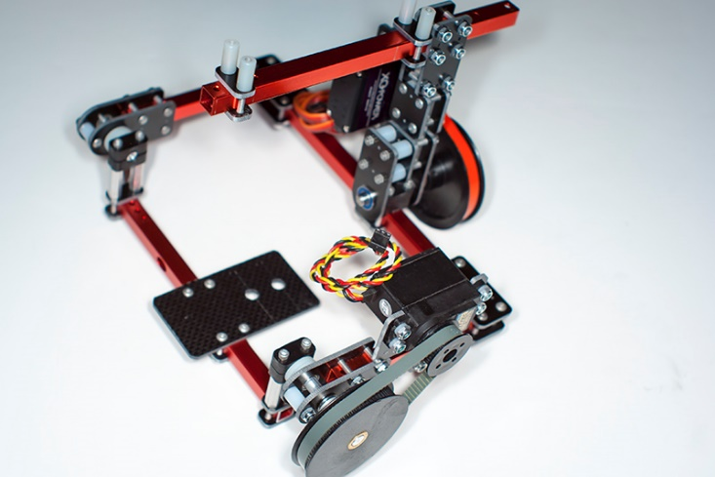
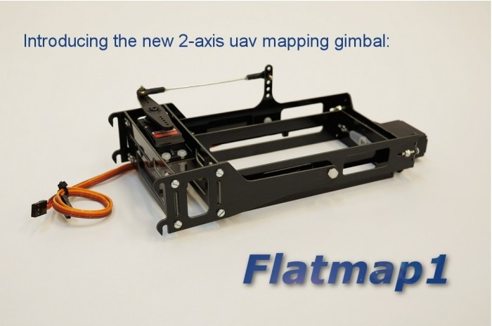
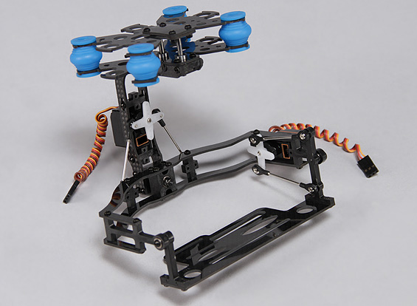
3. Using standard sero 1

Slide 10
3. Using standard sero 2
Advance
Easy coding and making
Cheap:
Price about 1,5M for 3 digital servo.
By digital servo at HCM city
Disadvance
Look simple too
Don’t know the step size of digital servo that smaller than step size of brushless?
Servo
KST 375k
http://saigon-hobby.com/category/207-align.aspx

Slide 11
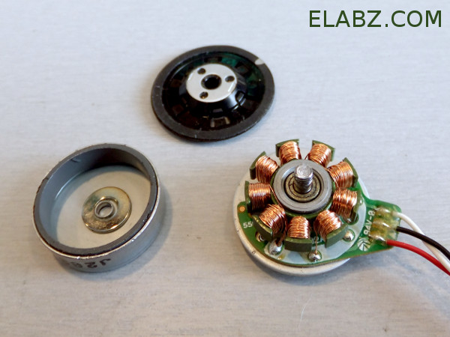
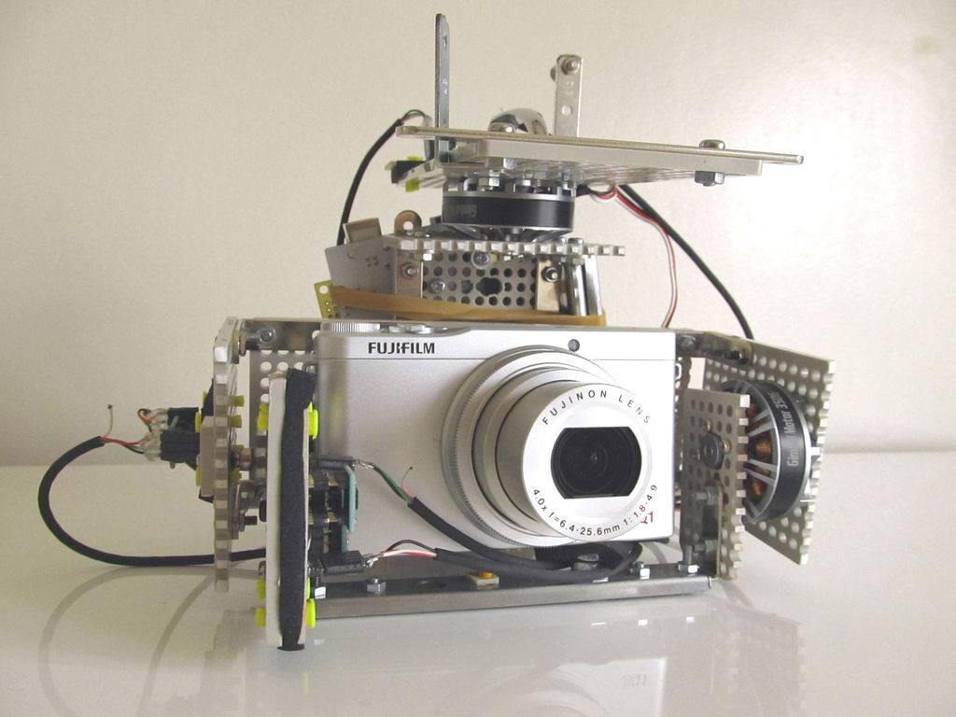
4. Reuse DVD brushless motor 1

Slide 12
4. Reuse DVD brushless motor 2
Advance
By using dvd brushless motor that reduce cost.
Step size can smaller than using servo.
Disadvance
Must perfrom driver board for brushless motor and coding.
Have more time for design board driver, coding and time for disgn the gimbal
Step size large?
We can make gimbal by use it???

Slide 13
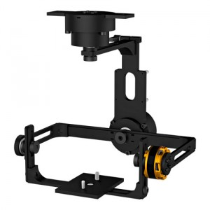
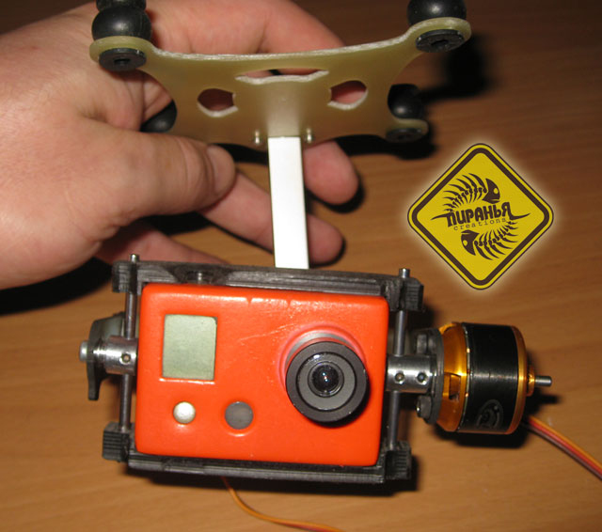
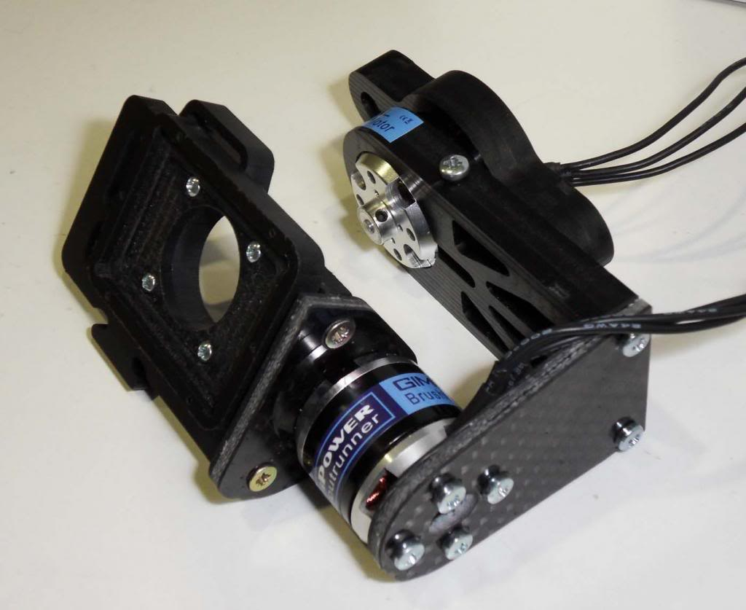
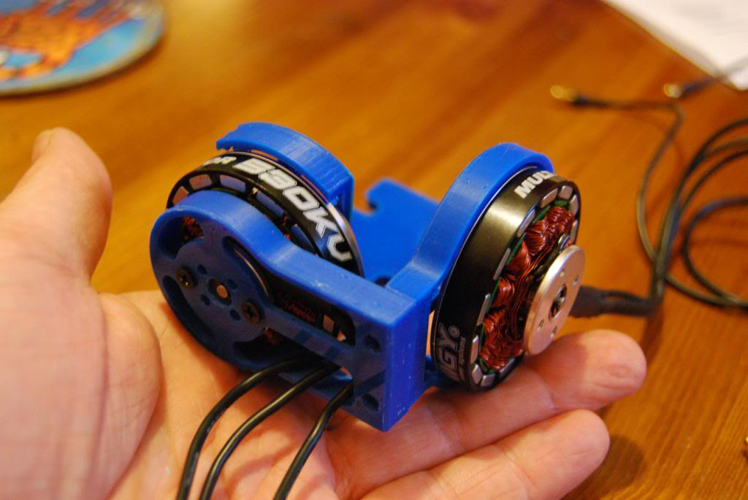
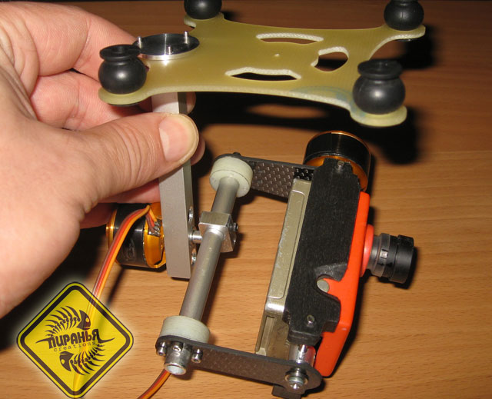
5. By new brushless 1

Slide 14
5. By new brushless 2
New brushless or using quadcopter brushless?
Can you control brushless motor?
Can you disgned gimbal body with use brushless motor

Slide 15
6. By new gimbal and coding
Gimbal – GoPro: 7M
Gimbal – GoPro – FlyCam: 5M2
Gimbal: 3M5

Slide 16
Final Sution
Here

Slide 17
According to vnpreview.vn the men who pursue science and technology are usually delusional their strength!

